Slide 1


Slide 2


Slide 3


Slide 4
indonesia

Slide 5


Slide 6


Slide 7


Slide 8


Slide 9


Slide 10


Slide 11



Slide 12



Slide 13


Slide 14


Slide 15



Slide 16


Slide 17


Slide 18


Slide 19


Slide 20


Slide 21
DaiWEEB

Slide 22


Slide 23


Slide 24


Slide 25



Slide 26


Slide 28


Slide 29


Slide 30


Slide 31
Anitoki

Slide 32
AOITENSHI

Slide 33


Slide 34


Slide 35


Slide 36


Slide 37
D-ANIMESUB

Slide 38
「DELSUBS」

Slide 39


Slide 40


Slide 41
Haruzora

Slide 42


Slide 43



Slide 44


Slide 45
ItoSubs

Slide 46


Slide 47


Slide 48



Slide 49


Slide 50

Quinime

Slide 51


Slide 52
ZenSub

Slide 53
Yuki Fansub

Slide 54
Bentoo Fansub

Slide 56
Excalibur Fansub

Slide 57
Curcol

Slide 58


Slide 59


Slide 60


Slide 61
Haruna Subs

Slide 62


Slide 63


Slide 64
K.O Anime

Slide 65

Notes:
Manga Neko Translator

Slide 66
Melody Fansub

Slide 67


Slide 68
Neosubs

Slide 69


Slide 70

Notes:
Panayagan

Slide 71
Pucuk Translation

Slide 72
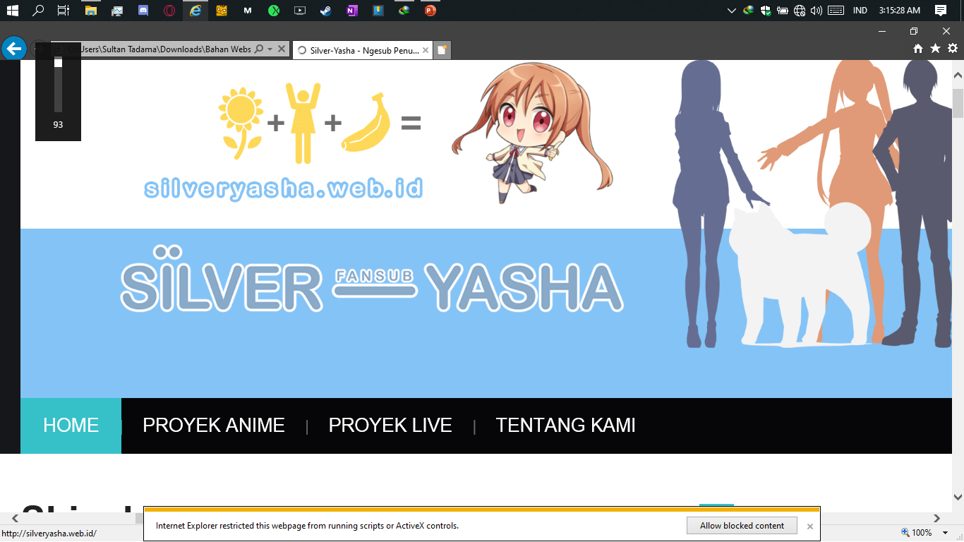

Slide 73
TTOD

Slide 74
WibuSubs

Slide 75


Slide 76


Slide 77

Notes:
Arks Fansubs

Slide 78


Slide 79


Slide 80
KINSHIRU FANSUB

Slide 81


Slide 82


Slide 83

Notes:
.to

Slide 84


Slide 85


Slide 86


Slide 87


Slide 88


Slide 89


Slide 90



Slide 92



Slide 93
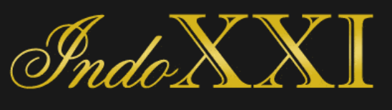
Notes:
http://103.194.171.75/

Slide 94


Slide 95

AniBatch

Slide 96
LOLIBATCH

Slide 97


Slide 98


Slide 99


Slide 100


Slide 101
Kusonime

Slide 102
Moenime

Slide 103


Slide 104


Slide 105


Slide 106
Nyaa.si

Slide 107


